Slide 1




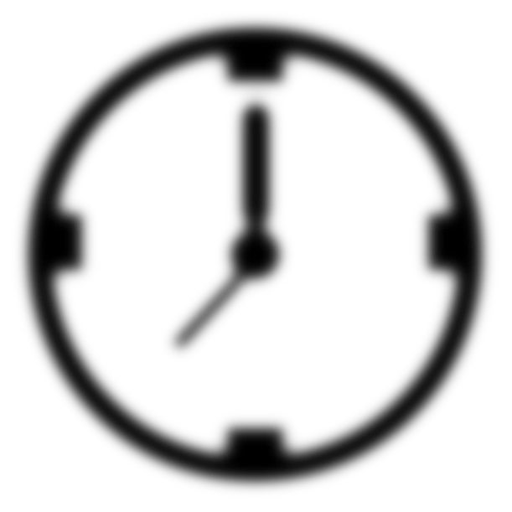
Chronos – All in 1 Clock App
Group 5
// Che Hutchinson Serju: @chehutchinsonserju
// Rene Tim: @Rascal20
// Shemar Davis: @shemardavis
// Lenroy Hinds : @Ljacenizer
// Theron Whorms: @terryron21
// Tavian Hall: @tavtav1

Slide 2
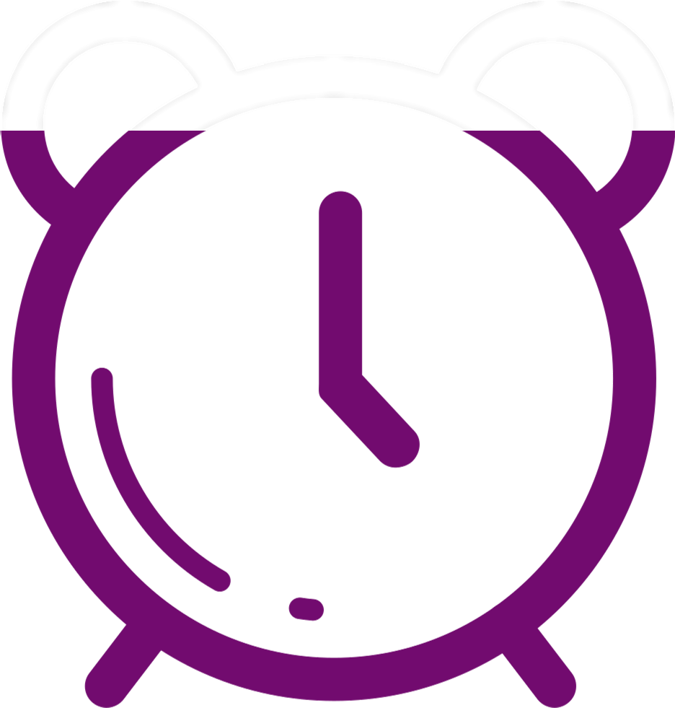
Problem Background
Time is Valuable, manage it as such
Time is a resource that we all make use of daily
Managing it is important
Some people may need support from an app

Slide 3









Target Audience
Our target audience is adults of all ages
Young Adults – Middle Aged – Elderly Folks

Slide 4
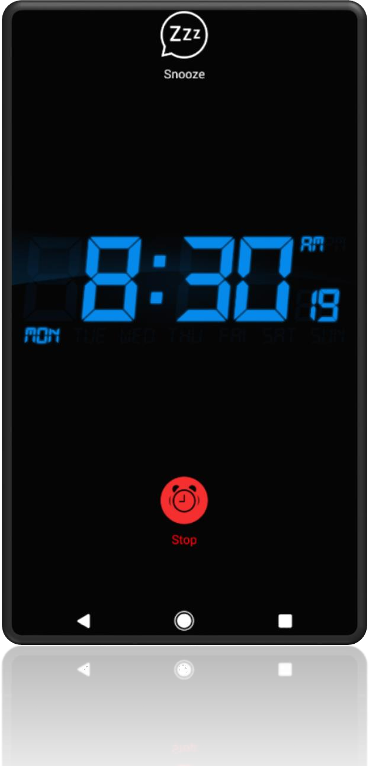
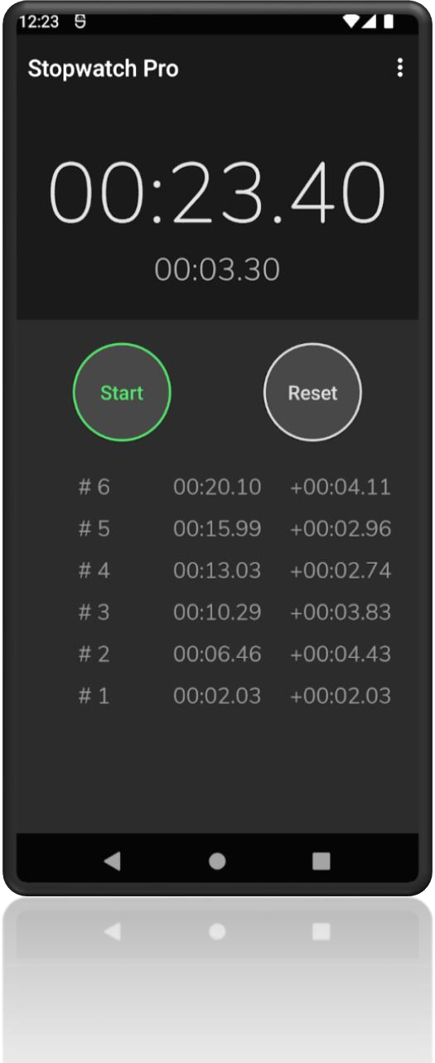
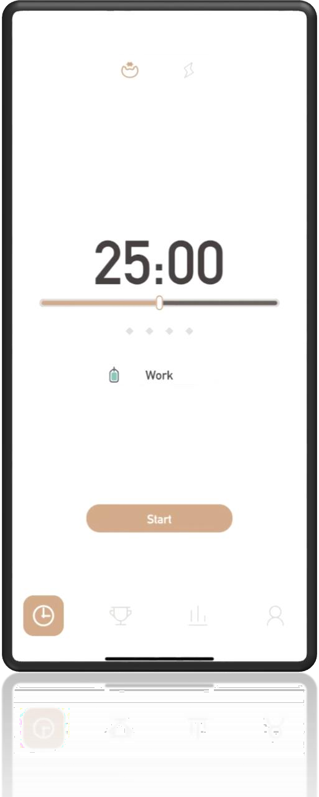
Possible Solutions: COMPETITORS
Striving: Pomodoro Focus Timer
Alarm Clock for
Me
Stopwatch Pro

Slide 5


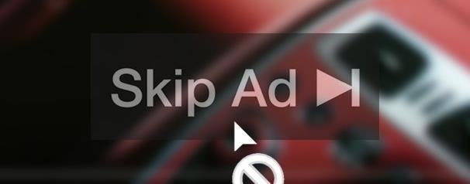


All in One
Everything in 1 place. Very convenient and saves
a good amount of time
No Ads
Ads are annoying. Especially ones that cannot be skipped when you want to do something
Simple Design
No need to make things complicated. A simple design is best for everyone

Slide 6




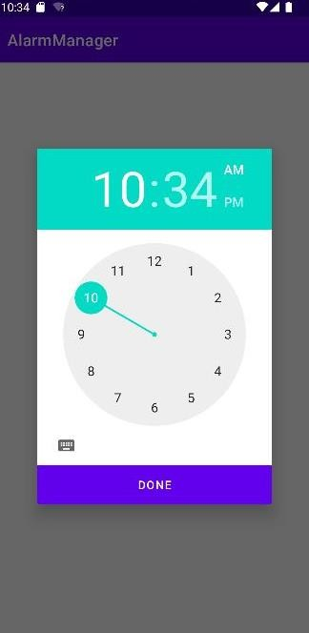
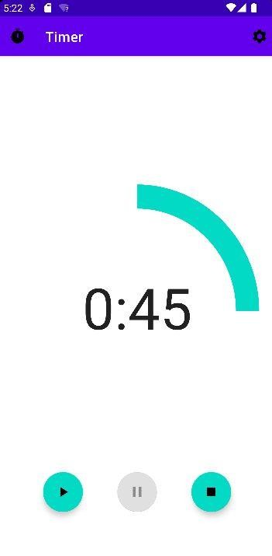
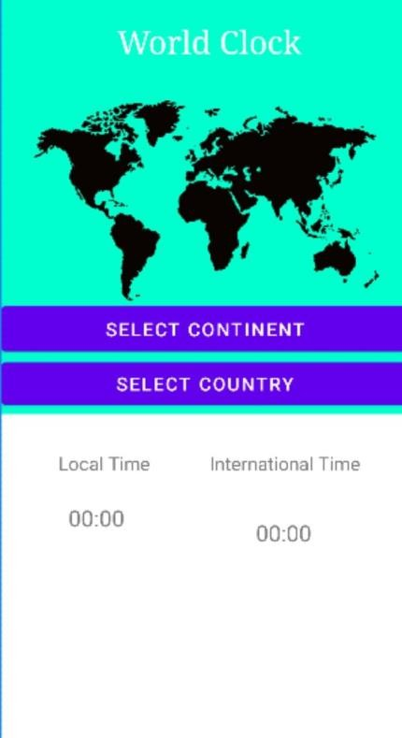
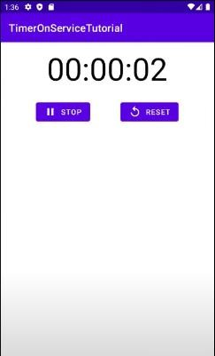
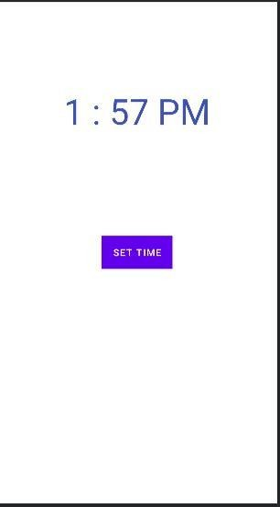

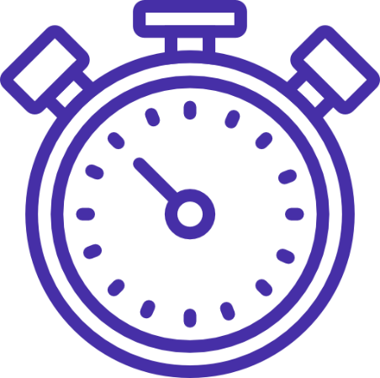
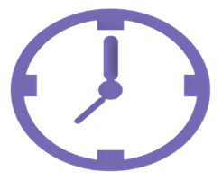
Designs
Standard Clock
Stopwatch
5:22 PM

Slide 7


Prototype
https://github.com/chehutchinsonserju/clock-app

Slide 8

What’s Next?
Adding functions to the clock
Making navigation smoother
Unifying UI elements
Refining the code

Slide 9
Conclusion

